Slide 1
EXERCISE 0
Flexpart by hand → without a computer ☺
Aims:
Thinking process to set-up a Flexpart run
Understand the files to be modified
Understand what information is needed to run Flexpart
Prepare a pen
Questions? Write delia.arnold-arias@zamg.ac.at

Slide 2
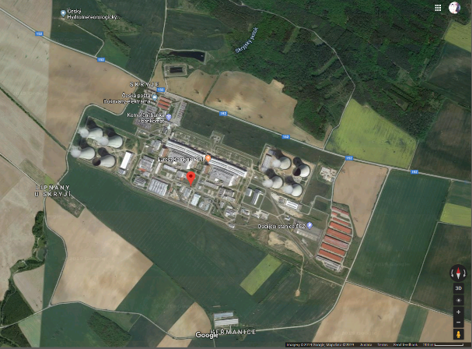
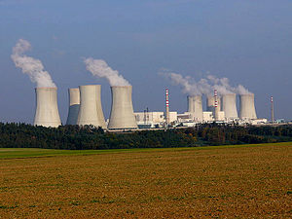
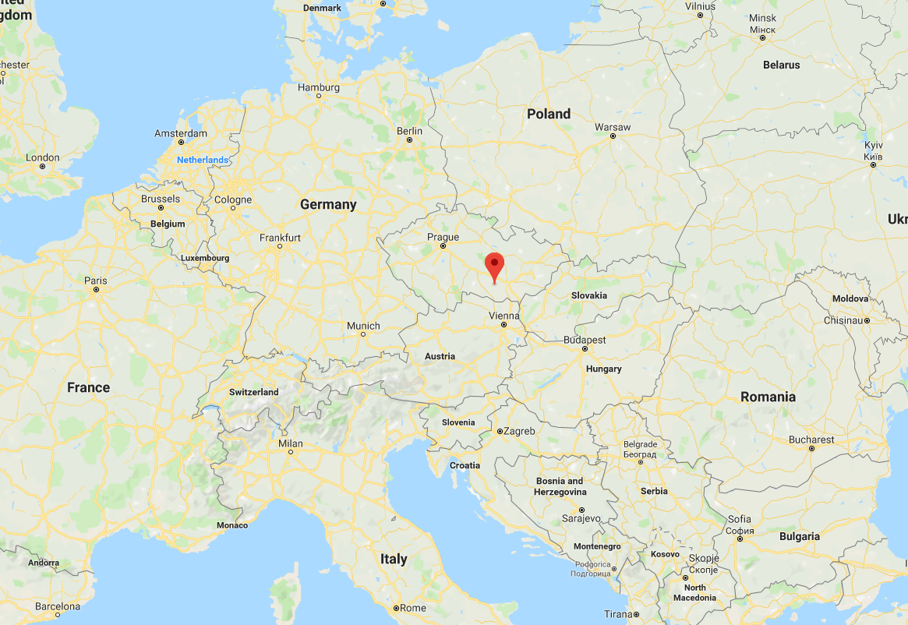
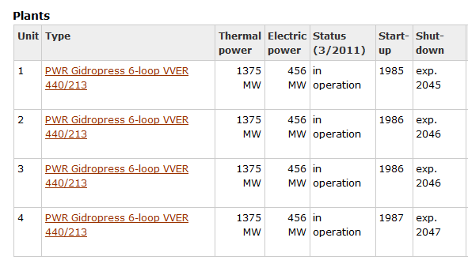
Facing a problem…
Dukovany NPP (49.0845 N / 16.1469 E) accident during night-time
T0 -20180905 000000 UTC
Is the situation dangerous for the highly populated area of Vienna?

Slide 3
Print-out material
Maps to:
  Understand locations
  Guide the domain definition
Input files:
  OUTGRID
  COMMAND
  RELEASES
  List of SPECIES
Guiding questions and discussion questions

Slide 4
Example results
Results:
Is a single set-up the only possibility for an event? No. Set-up and trade-offs depend on what we want to answer. For example:
  Do we want time series at receptors to understand measurements?
  How far are we from the source?
  What domains have we chosen?
  What time steps?
  What species have we used?
  What meteorological information to use
  Number of particles? More → slower, less → faster (but more uncertain)
  How many vertical levels? Am I only interested at the lower level (where people live?)
  Do we use adaptative timesteps according to TL?
  ….

Slide 5
Example results – set-up
RELEASES
COMMAND
&COMMAND
LDIRECT= 1,
IBDATE= 20180905,
IBTIME= 0,
IEDATE= 20180905,
IETIME= 60000,
LOUTSTEP= 3600,
LOUTAVER= 3600,
LOUTSAMPLE= 900,
ITSPLIT= 9999999,
LSYNCTIME= 900,
CTL= -5.00000000 ,
IFINE= 4,
IOUT= 1,
IPOUT= 0,
LSUBGRID= 0,
LCONVECTION= 0,
LAGESPECTRA= 0,
IPIN= 0,
IOUTPUTFOREACHRELEASE= 0,
IFLUX= 0,
MDOMAINFILL= 0,
IND_SOURCE= 1,
IND_RECEPTOR= 1,
MQUASILAG= 0,
NESTED_OUTPUT= 0,
LINIT_COND= 0,
LNETCDFOUT= 0,
SURF_ONLY= 0,
CBLFLAG= 0,
OHFIELDS_PATH="../../flexin/ ",
/
&RELEASES_CTRL
NSPEC= 1,
SPECNUM_REL= 21,
/
&RELEASE
IDATE1= 20180905,
ITIME1= 0,
IDATE2= 20180905,
ITIME2= 30000,
LON1= 16.1469002 ,
LON2= 16.1469002 ,
LAT1= 49.0844994 ,
LAT2= 49.0844994 ,
Z1= 0.00000000 ,
Z2= 50.0000000 ,
ZKIND= 1,
MASS= 9.99999984E+16,
PARTS= 100000,
COMMENT="Dukovany ",
/
Hourly output
OUTGRID
&OUTGRID
OUTLON0= -30.0000000 ,
OUTLAT0= 30.0000000 ,
NUMXGRID= 700,
NUMYGRID= 450,
DXOUT= 0.100000001 ,
DYOUT= 0.100000001 ,
OUTHEIGHTS= 100.000000 ,
/

Slide 6
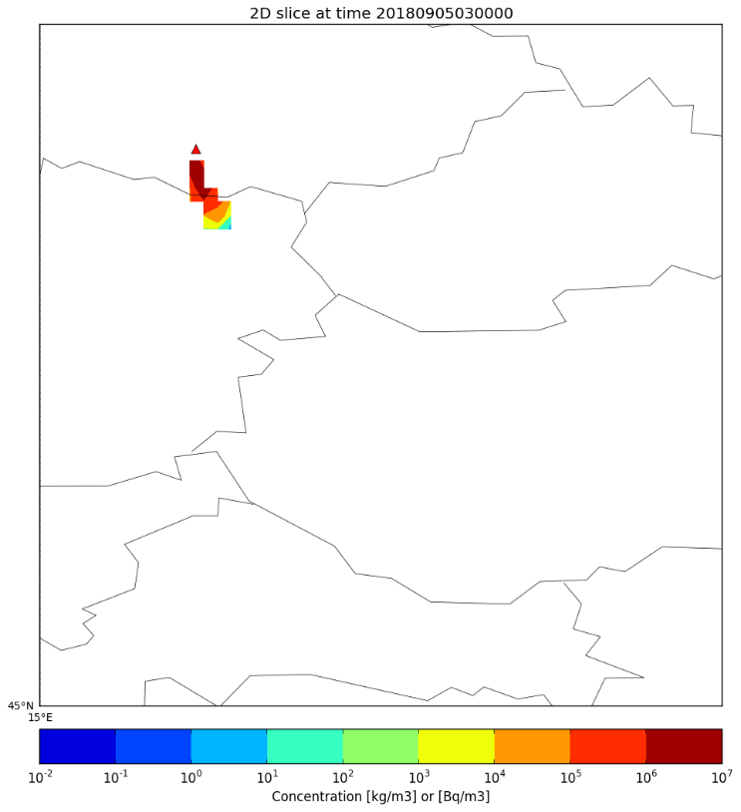
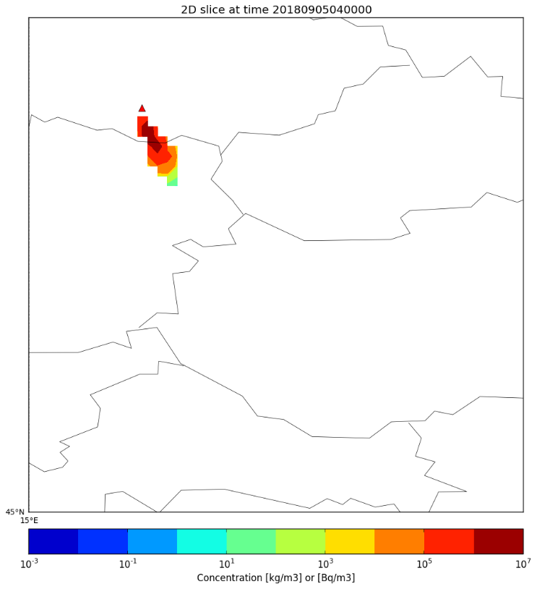
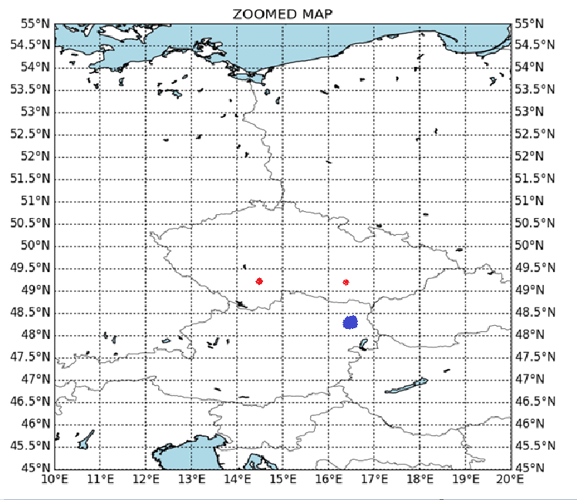
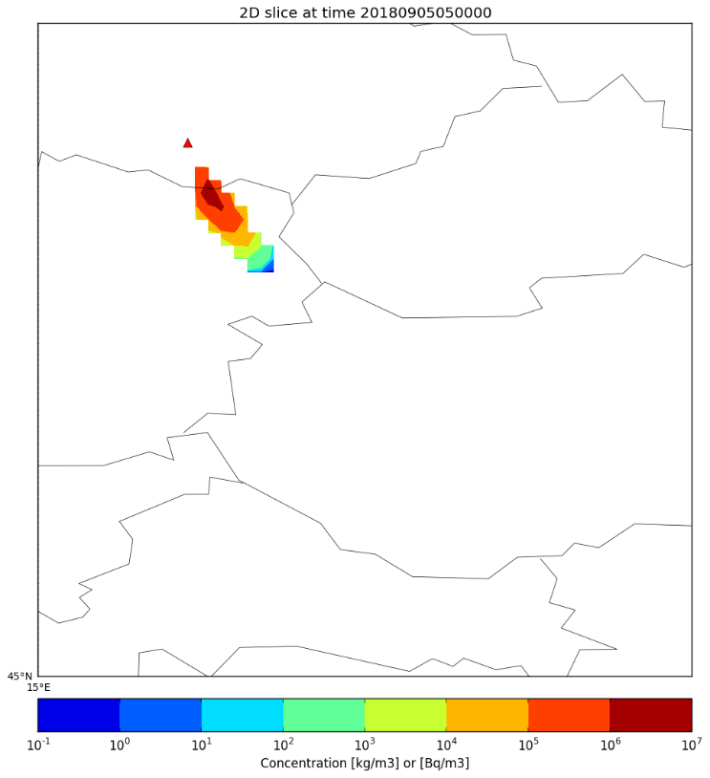
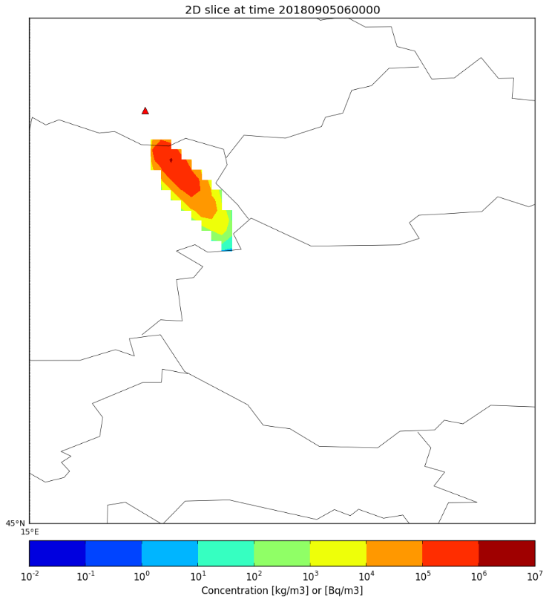
Example results – what do we see?
Concentration at ground level
Vienna reached 5 hours after the initiation of the release

Slide 7
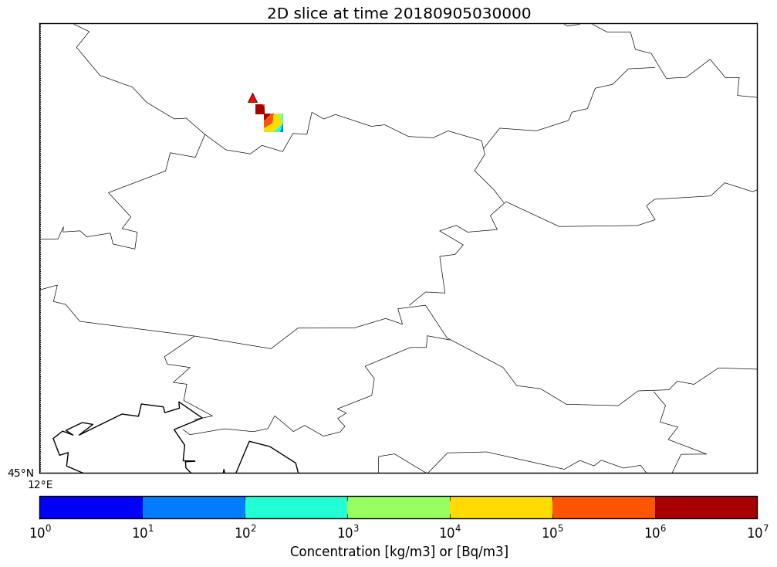
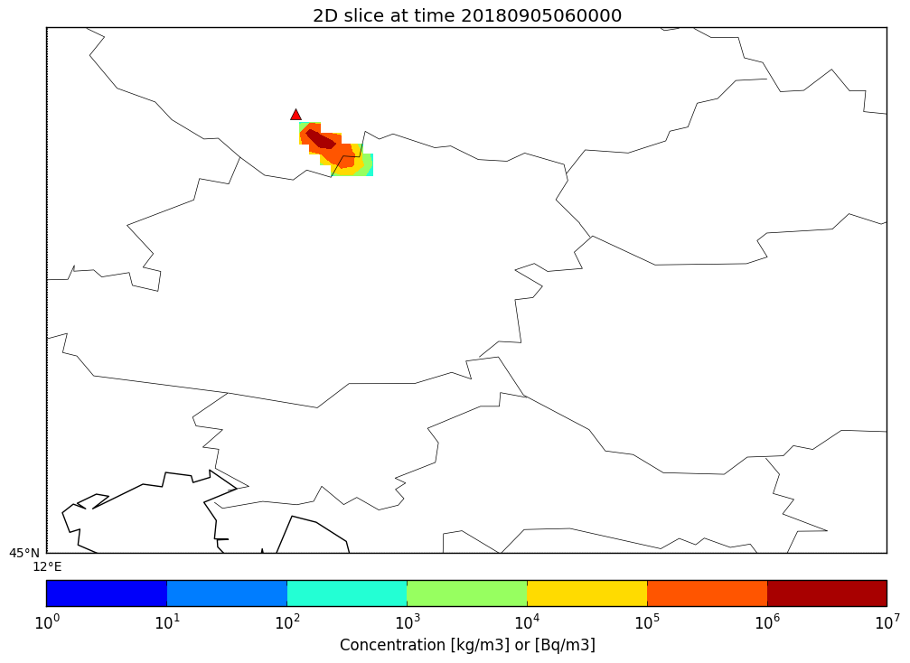
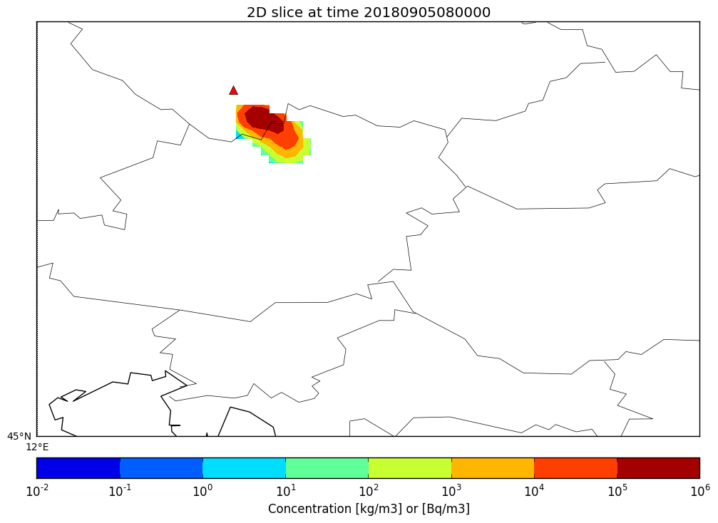
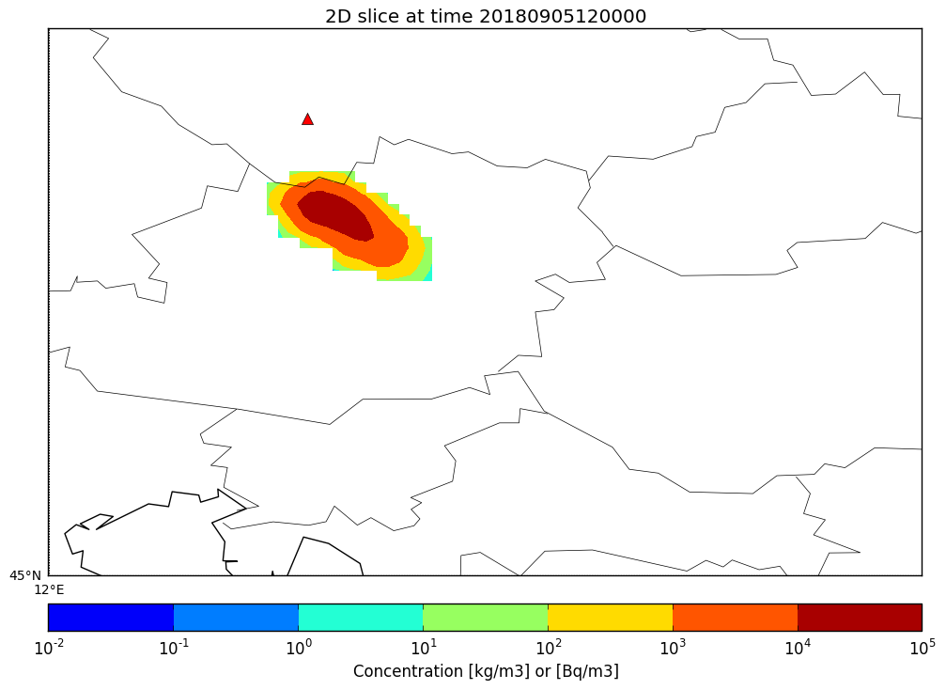
What if it was Temelin?

